Slide 1
Lesson Overview
This course provides an introduction to the National Response Framework. The course is divided into four lessons.
To help you keep track of your place in the course, the current lesson title will be displayed in the center of the screen under the course title. In addition, a Lesson List will be presented at the beginning and end of each lesson.
Each lesson overview will state the approximate length of the lesson.

Slide 2
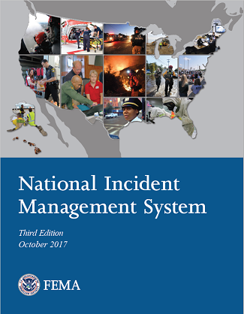
Relationship to NIMS
The response protocols and structures described in the National Response Framework align with the National Incident Management System (NIMS). All of the components of the NIMS support response —including resource management, command and coordination*, communications and information management.
Standardizing national response doctrine with NIMS provides a consistent, nationwide template to enable the whole community to work together to prevent, protect against, mitigate, respond to, and recover from the effects of incidents regardless of their cause, size, location, or complexity.
*The NRF incorrectly uses the term "management and coordination".
View the National Incident Management (https://www.fema.gov/national-incident-management-system) document to learn more.

Slide 3
Intended Audience
The National Response Framework is intended to provide guidance for the whole community. Within this broad audience, the National Response Framework focuses especially on those who are involved in delivering and applying the response core capabilities, including:
  Private sector partners
  Non-governmental organizations (NGOs)
  Government officials
  Community leaders
  Emergency management practitioners
  First responders

Slide 4
Intended Audience, continued
All elements of the community must be activated, engaged, and integrated to respond to a major or catastrophic incident. By providing equal access to acquire and use the necessary knowledge and skills, this Framework is intended to enable the whole community to contribute to and benefit from national preparedness.
This includes:
  Children
  Older adults
  Individuals with disabilities and others with access and functional needs
  Those from religiously, racially, and ethnically diverse backgrounds
  People with limited English proficiency
  Owners of animals, including household pets and service and assistance animals

Slide 5

Introducing the National Response Framework

Slide 6
Why the Framework is Always in Effect
NRF elements can be implemented at any time for any hazard, including the employment of Emergency Support Function (ESF) mechanisms.
The structures, roles, and responsibilities described herein can be partially or fully implemented in the context of a threat or hazard, in anticipation of a significant event, or in response to an incident.
Implementation of NRF structures and procedures allows for a scaled response, delivery of the specific resources and capabilities, and a level of coordination appropriate to each incident.

Slide 7
Knowledge Review 1
Based on the information presented, take a few minutes to discuss how the National Response Framework is intended to provide guidance to the whole community. In this context, what does the whole community include?
Be prepared to discuss your answers.

Slide 8
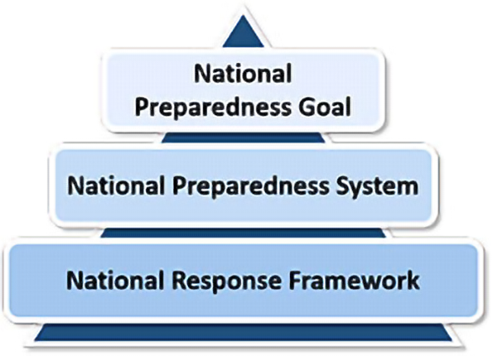
Part of a Broader Strategy
To better understand how the National Response Framework fits into the overall national preparedness efforts, we need to look at the National Preparedness System (NPS) and the National Preparedness Goal. The NPS was developed to provide the approach, resources, and tools to aid the whole community in its preparedness activities to achieve the National Preparedness Goal. Part of this system involves determining what capabilities are needed, how they should be developed and sustained, and how they should be delivered.

Slide 9
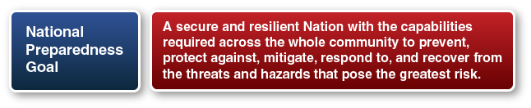
National Preparedness Goal
The National Preparedness Goal presents an integrated, layered, and whole community approach to preparedness. The Goal itself is a result of contributions from the whole community. It recognizes that everyone can contribute to and benefit from national preparedness efforts.

Slide 10
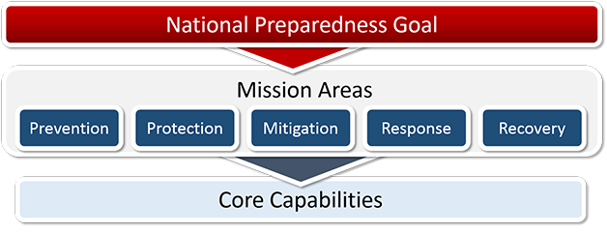
Mission Areas and Capabilities (1 of 3)
The National Preparedness Goal defines what it means for the whole community to be prepared for all types of disasters and emergencies. The goal is:
"A secure and resilient nation with the capabilities required across the whole community to prevent, protect against, mitigate, respond to, and recover from the threats and hazards that pose the greatest risk."
This goal sets the vision for preparedness nationwide and identifies the core capabilities necessary to achieve that vision across five mission areas: Prevention, Protection, Mitigation, Response, and Recovery.

Slide 11
Mission Areas and Capabilities (2 of 3)
Keep in mind that these 5 mission areas aid in organizing our national preparedness activities and enhance coordination of the core capabilities within each mission area.
Successful achievement of the National Preparedness Goal will result in a secure and resilient nation with the capabilities required across the whole community to prevent, protect against, mitigate, respond to, and recover from the threats and hazards that pose the greatest risk.
Learn more about the National Preparedness Goal (www.fema.gov/national-preparedness-goal).

Slide 12
Mission Areas and Capabilities (3 of 3)
There are 5 mission areas. Each mission area is comprised of the capabilities required for accomplishing the mission or function at any time (before, during, or after an incident) and across all threats and hazards. The mission areas are not sequential; activities from multiple mission areas can occur simultaneously.
  Prevention
  Protection
  Mitigation
  Response
  Recovery
Learn more about the National Response Framework (www.fema.gov/national-planning-frameworks).

Slide 13
Core Capabilities (1 of 2)
Both the National Preparedness System and the National Preparedness Goal discuss the development of capabilities needed to ensure a secure and resilient nation. These core capabilities are the way we can measure, describe, and implement our security and resilience techniques.
The National Planning Frameworks, one framework for each mission area, discuss how whole community efforts build, sustain, and deliver these core capabilities.
Throughout this course, we will focus specifically on the Response core capabilities. These capabilities are discussed in detail in Lesson 3: Core Capabilities.

Slide 14
Core Capabilities (2 of 2)
Under all five mission areas (Prevention, Protection, Mitigation, Response, and Recovery) there are a combined total of 32 core capabilities. These capabilities are highly interdependent and require us to use existing preparedness networks and activities, to coordinate and unify efforts, to improve training and exercise programs, to promote innovation, and to ensure that the administrative, finance, and logistics systems are in place to build, sustain, and deliver the capabilities. There are a number of key characteristics of these capabilities that you should remember.
The core capabilities:
  Are distinct critical elements necessary to meet the National Preparedness Goal
  Are essential for the execution of each mission area: Prevention, Protection, Mitigation, Response, and Recovery
  Provide a common language for preparedness across the whole community
  Are not exclusive to any single level of government or organization and encompass the whole community
More information regarding the National Preparedness System, the National Preparedness Goal, and Core Capabilities can be found in the IS-2000: National Preparedness Goal and System: Overview (training.fema.gov/is/courseoverview.aspx?code=IS-2000).

Slide 15
Whole Community Preparedness
Preparedness depends on efforts at all levels, including individuals and communities, the private and nonprofit sectors, faith-based organizations, and all levels of government (local, regional/metropolitan, state, tribal, territorial, insular-area, and Federal). The contributions of all must be integrated into preparedness efforts, and the needs of all must be addressed in planning for the development of response capabilities. Whole community includes:
  Individuals and families, including those with access and functional needs
  Businesses
  Faith-based and community organizations
  Nonprofit groups
  Schools and academia
  Media outlets
  All levels of government, including state, local, tribal, territorial, and federal partners
Read A Whole Community Approach to Emergency Management: Principles, Themes, and Pathways for Action (www.fema.gov/whole-community).

Slide 16
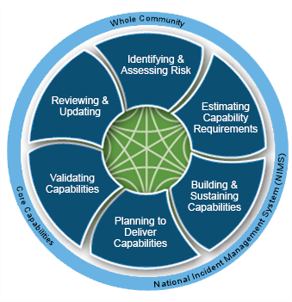
National Preparedness System
The National Preparedness System is an integrated set of guidance, concepts, processes, and tools that enable the whole community to meet the National Preparedness Goal.
The system is made up of the six components shown in the graphic. More information is available at the National Preparedness System (www.fema.gov/national-preparedness-system).

Slide 17
Whole Community Preparedness Example
Experience shows one of the best things the whole community can do to be prepared is provide universal accessibility. This simply means planning to meet the needs of the whole community by providing physical access, communication access, or access to disaster or emergency programs. In addition, there are legal requirements that dictate the inclusion of persons with disabilities during whole community preparedness efforts.
One way to ensure this example is incorporated into planning is to establish a Core Advisory Group (CAG). CAGs consist of people with cross-disabilities who advise emergency managers. They provide input on inclusive emergency operations plans, including:
  Local, jurisdictional, or state accessible evacuation plans
  Temporary accessible housing plans
  Accessibility to, of, and in shelters

Slide 18
The National Response Framework
To assist response partners in effectively carrying out the Response mission, the National Response Framework:
  Identifies capabilities that are essential for response and community lifelines stabilization
  Indicates the actions necessary to build and deliver the required capabilities
  Describes key roles and responsibilities for integrating capabilities across the whole community
  Outlines how the Response mission area relates to other mission areas

Slide 19
Response Federal Interagency Operational Plan
At the Federal level, the National Response Framework is supported by the Response Federal Interagency Operational Plan (FIOP). The Response FIOP further defines the concepts, principles, structures, and actions introduced in the National Response Framework, with a focus on the Federal level.
The Response FIOP goes into more depth than the National Response Framework on how Federal agencies work together on Response and how they support or complement activities that take place in the private sector and at other levels of government.
The intent of the FIOP is to support local, state, tribal, territorial, insular-area, and Federal government plans to ensure a common operational focus.
Each mission area has their own FIOP that describes how the federal government aligns resources and delivers that mission's core capabilities. Read more at the National Preparedness System (www.fema.gov/federal-interagency-operational-plans).

Slide 20
Knowledge Review 2
Discuss the benefits of implementing NRF structures and procedures?
Be prepared to discuss your answers.

Slide 21
Knowledge Review 3
Based on the information presented, take a few minutes to explain the characteristics of the Core Capabilities.
Be prepared to discuss your answer.

Slide 22
Guiding Principles for Response
Now that you have a general understanding of National Preparedness doctrine and the context it provides for the Response mission area, let’s take a closer look at the principles on which Response doctrine is based.
Response doctrine defines basic roles, responsibilities, and operational concepts for Response across all levels of government and with the private sector and nongovernmental organizations.
It is important to remember that the overarching objective of Response activities is ensuring life safety, protecting property and the environment, stabilizing the incident, and providing for basic human needs. Stabilization of the seven Community Lifelines reduces threats to public health and safety, or economic security. Let’s review the five guiding principles that establish fundamental doctrine for the Response mission area:Engaged Partnership
  Tiered Response
  Scalable, Flexible, and Adaptable Operational Capabilities
  Unity of Effort Through Unified Command
  Readiness to Act

Slide 23
Engaged Partnership
Effective partnership relies on engaging the whole community in preparing for and responding to disasters in order to manage risk to communities and infrastructure.
Those who lead emergency response efforts must communicate and support engagement with the whole community by developing shared goals and aligning capabilities to reduce the risk of any jurisdiction being overwhelmed in times of crisis. Layered mutually supporting capabilities of individuals, communities, the private sector, Non-government Organizations (NGOs), and governments at all levels allow for coordinated planning in times of calm and effective response in times of crisis.
Now let’s look at an example that demonstrates the concept of engaged partnership.

Slide 24
Engaged Partnership Example
In the wake of the tornado that hit Joplin, Missouri in May 2011, every available agency and resource was deployed to assist in response and recovery from the devastating event. A wide array of private businesses participated in that effort:
  Home improvement stores delivered relief and cleanup supplies that were contributed by other private-sector suppliers. These businesses also partnered with a commercial airline to fly in volunteers.
  Utility companies teamed up to restore power more quickly to the area.
  A telecommunications company provided wireless equipment to local emergency officials.
  A development firm worked with the Joplin City Council to attract private investors for reconstruction projects.
Through this whole community approach, government and businesses coordinated their efforts to begin the response and rebuilding process in Joplin.

Slide 25
Tiered Response
A basic premise of the National Response Framework is that incidents are generally handled at the lowest jurisdictional level possible. Incidents begin and end locally, and most are managed at that level as well.
Many incidents require unified response from local agencies, the private sector, and nongovernmental organizations. Other incidents may require additional support from neighboring jurisdictions or the state.
A small number require Federal support. National response protocols recognize this and are structured to provide additional, tiered levels of support.
When all levels of government become engaged, a response is federally supported, state managed, and locally executed, with tribes, territories, and insular area governments often managing the response, as well.

Slide 26
Tiered Response Example
In Illinois, mutual aid for multiagency or multi-jurisdictional response is provided through the Mutual Aid Box Alarm System (MABAS). Equipment, personnel, or services that are provided under the MABAS agreement are shared between municipalities at no cost. In the event there are expenses recovered from the responsible party, those funds are equitably distributed. In addition, emergency personnel who respond to the emergency remain employees of their initial department or agency.
MABAS may be activated for larger incidents under the Illinois Emergency Management Agency’s statewide mutual aid plan. The statewide plan allows for resource deployment to a stricken area while leaving at least 80 percent of local resources in place to respond to ongoing, routine local emergencies.
The MABAS system is organized in divisions, roughly along county lines, and the vast majority of firefighters in Illinois participate in the system. Several surrounding States—Wisconsin, Iowa, and others—also use MABAS, and the groundwork is being laid throughout the Great Lakes region to establish a compatible mutual aid system modeled after MABAS.

Slide 27
Scalable, Flexible, and Adaptable Operational Capabilities
As incidents change in size, scope, and complexity, response efforts must adapt to meet evolving requirements. The number, type, and sources of resources must be able to expand rapidly to meet the changing needs associated with a given incident and its cascading effects. The National Incident Management System (NIMS) concepts and principles add this flexibility when dealing with an incident.
As needs grow and change, response processes must remain nimble and adaptable. The structures and processes described in the NRF must be able to surge resources from the whole community.
As incidents stabilize, response efforts must be flexible in order to move toward recovery outcomes.

Slide 28
Scalable, Flexible, and Adaptable Operational Capabilities Example
Based on lessons learned from the 9/11 attacks, the New York City Fire Department (FDNY) established and trained Incident Management Teams (IMTs).
The IMTs are designed to provide operational capabilities to ensure that the Department has continuous coverage during prolonged incidents. Each team member is trained and credentialed to assume specific Incident Command System (ICS) functions.
When Hurricane Katrina made landfall in August 2005 in Louisiana and Mississippi, FDNY had enough trained personnel to deploy a full IMT to assist in the response. During Hurricane Sandy in 2012, with the crisis closer to home, an IMT oversaw the response during and after the storm.
The FDNY IMTs demonstrated scalable, flexible, and adaptable capabilities by responding to incidents of different size, location, and complexity.

Slide 29
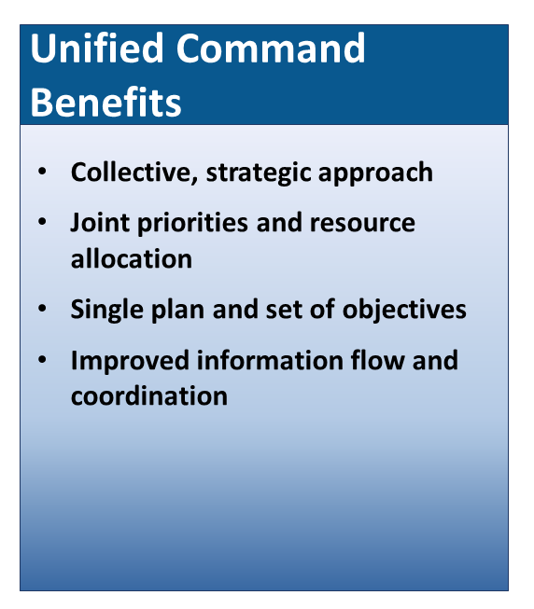
Unity of Effort Through Unified Demand
Success requires unity of effort, which respects the chain of command of each participating organization while ensuring seamless coordination across jurisdictions in support of common objectives.
As a team effort, Unified Command allows all agencies with jurisdictional authority and/or functional responsibility for the incident to provide joint support through mutually developed incident objectives and strategies. Each participating agency maintains its own authority, responsibility, and accountability.
Unified command is an Incident Command System (ICS) application used when more than one agency has jurisdiction or when incidents cross political jurisdictions. Agencies work together through the designated members of the unified command to establish a common set of objectives and strategies and a single Incident Action Plan.
As a team effort, unified command allows all agencies with jurisdictional authority and/or functional responsibility for the incident to provide joint support through mutually developed incident objectives and strategies established at the command level. Each participating agency maintains its own authority, responsibility, and accountability.

Slide 30
Unity of Effort Through Unified Command Example
Planned events in Boston can attract crowds of 1 million or more participants and spectators, providing an optimal environment to test and improve disaster plans.
Medical planners, led by Boston Emergency Medical Services, began treating special events as “planned disasters” during preparations for events such as the Boston Marathon.
Agencies and organizations involved adopted the Incident Command System, conducted planning and operations using unified command, and integrated aspects of the Region’s disaster plans into the event’s operations plan.
These preparations proved vital when bomb blasts ripped through the crowd at the 2013 Boston Marathon. Lives were saved that day through the united efforts of diverse agencies, medical services, and individual community members.

Slide 31
Readiness To Act
Effective response requires a readiness to act that is balanced with an understanding of the risks and hazards responders face. From individuals and communities to the private and nonprofit sectors, faith-based organizations, and all levels of government, national response depends on the ability to act decisively.
Decisive action is often required to save lives and protect property and the environment. Although some risk to responders may be unavoidable, all response personnel are responsible for anticipating and managing risk through proper planning, organizing, equipping, training, and exercising.

Slide 32
Readiness To Act Example
FEMA’s Incident Management Assistance Teams (IMATs) are rapidly deployable emergency response teams—full time, rapid response teams that can arrive at an incident within 12 hours from deployment notification to support the State and Federal Coordinating Officers in establishing the Incident Action Planning (IAP) process and Initial Operating Facility (IOF).
IMAT teams:
  Support the initial establishment of a Unified Command
  Provide situational awareness for Federal and state decision-makers, enabling them to determine the level and type of immediate Federal support that may be required

Slide 33
Knowledge Review 4
Break into small groups and order the following from lowest to highest jurisdictional level.
Be prepared to discuss the level most incidents are handled, and why.
  State/Tribal Resources
  State-to-State and Regional Resources
  Federal Resources
  Local Response

Slide 34
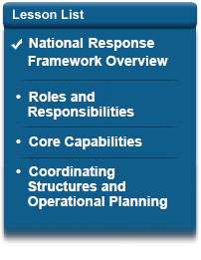
Lesson 1 Summary
In this lesson, you reviewed National Response Framework that includes the purpose, audience, scope, organization, and relationship to the National Incident Management System (NIMS).
In addition, you learned the National preparedness doctrine and the Guiding Principles doctrine.
The next lesson defines the response roles and responsibilities of the Response mission area.

